Slide 1


Phishing Awareness Training
Cybersecurity Internship-Christine Khayat

Slide 2
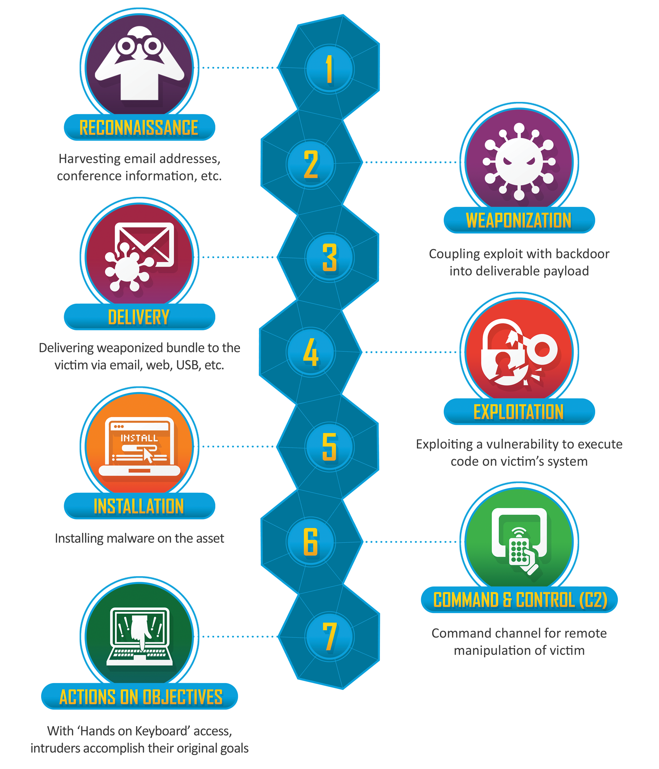
What is Phishing
What Phishing is
a type of cyberattack where criminals pretend to be a trusted person or company to trick you into sharing private information like passwords, credit card numbers, or bank details
Why Attackers use it
Attackers use phishing because it is highly effective, cheap, and exploits human psychology rather than secure computer systems.

Slide 3
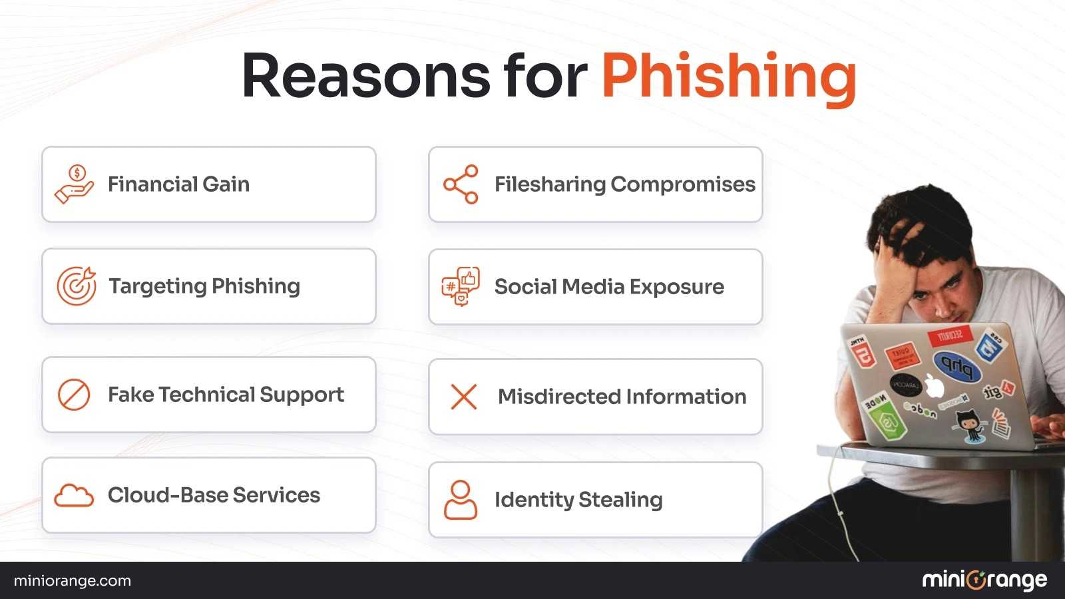
Key Reasons Attackers Use Phishing
Human Vulnerability: It is easier to trick a human into giving up a password than it is to hack through advanced security software
Low Cost: Sending millions of fake emails or text messages costs virtually nothing
High ROI: Attackers only need a tiny fraction of victims to fall for the scam to make a massive profit
Speed: Massive phishing campaigns can be launched globally in seconds
Easy Automation: Hackers use automated tools and AI to generate convincing text and fake landing pages rapidly
Anonymity: Cybercriminals can easily hide behind spoofed email addresses, fake phone numbers, and hidden web domains
Direct Access: Stealing a legitimate password gives attackers full control over a system without raising immediate red flags

Slide 4
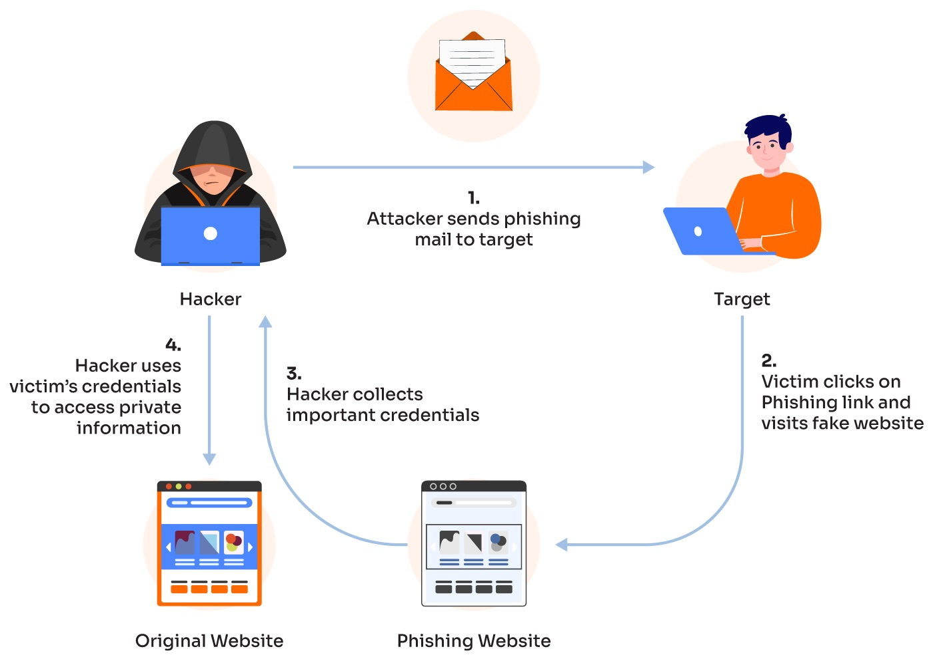
How Phishing Works

Slide 5
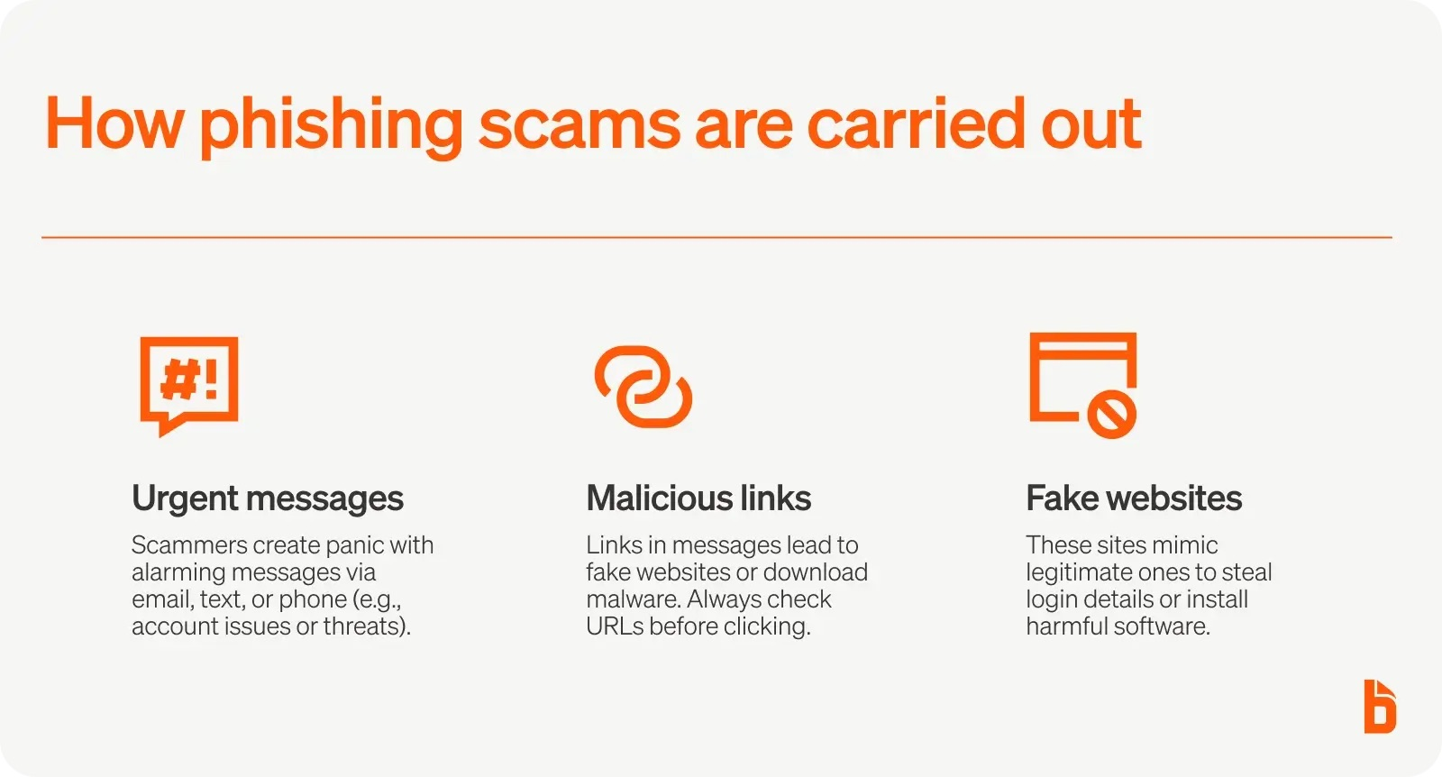
How to recognize Phishing Email
Common Signs
Suspicious sender email
Urgent/threatening language
Unexpected attachments
Suspicious links
Spelling/grammar inconsistencies
Requests for passwords or financial information
Offers that seems too good to be true

Slide 6
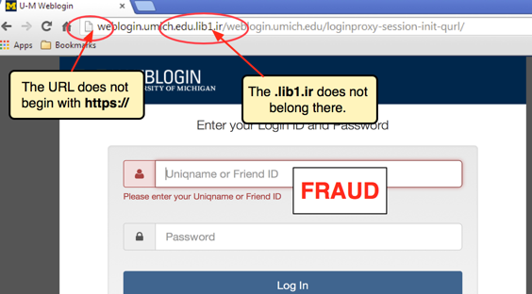

How to identify a Fake Website
Key Indicators of a Fake Website
Lookalike Domain Names: Check the address bar for typos, extra letters, or weird extensions (like .com.co or .pay-paypal.com instead of .com)
Missing or Mismatched HTTPS: Genuine secure sites use HTTPS, but modern scammers use it too. Ensure the padlock icon is present and matches the brand you expect
Urgent Calls to Action: Scams often feature large pop-ups demanding immediate payment or warning that your account will be deleted
Suspicious Payment Methods: Avoid sites that demand payment via wire transfers, cryptocurrency, or gift cards instead of standard credit cards
Low-Quality Design: Look for blurry logos, broken links, formatting issues, and obvious spelling or grammatical errors
No Contact Info: Fake sites rarely have a legitimate "About Us" page, verifiable physical address, or working phone number
Young Domain Age: Use an online WHOIS tool to see when the site was created; scams usually feature websites created only days or weeks ago

Slide 7
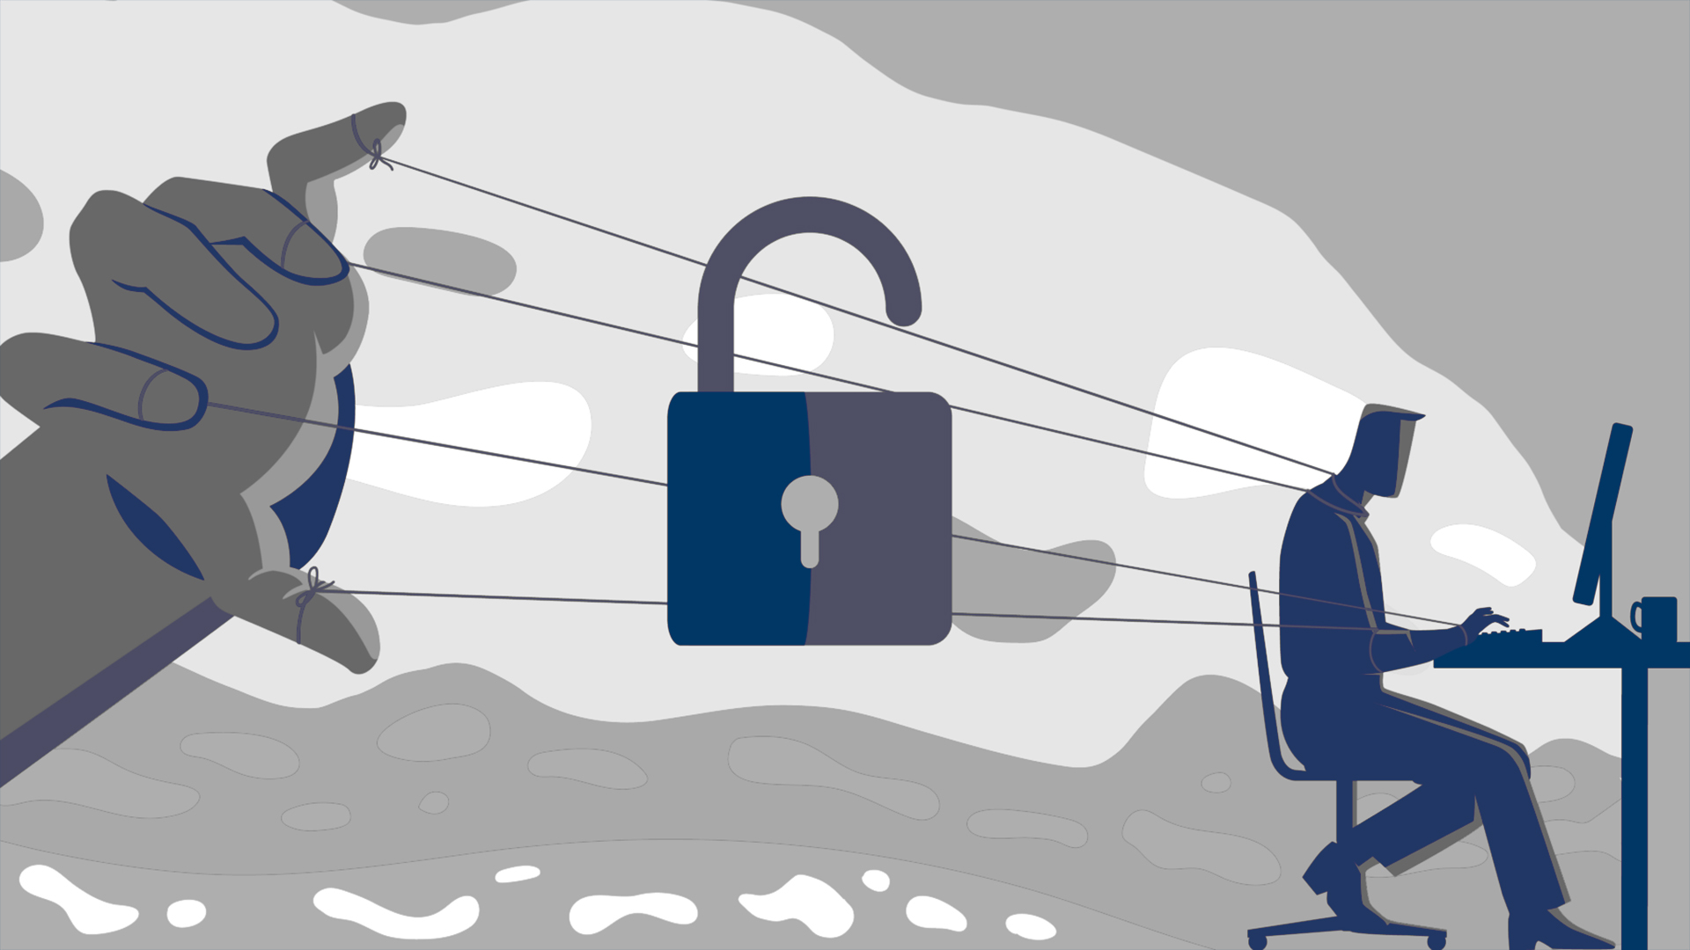
Social Engineering
Social engineering is the psychological manipulation of people into performing actions or divulging confidential information. It focuses on hacking human psychology rather than exploiting computer hardware or software vulnerabilities
Core Techniques Used
Pretexting: Attackers fabricate a false scenario (a pretext) to steal information, often pretending to be a bank auditor, HR representative, or tech support
Baiting: Criminals offer something enticing—like a free software download, a movie link, or even a physical USB drive left in a parking lot—to infect systems with malware
Quid Pro Quo: Attackers offer a fake service or benefit in exchange for information, such as calling an employee claiming to be IT support fixing a network issue
Tailgating (Piggybacking): Someone without proper authorization physically follows an authenticated employee into a restricted secure building
Phishing: The most common form of digital social engineering, using deceptive emails or texts to trick users

Slide 8
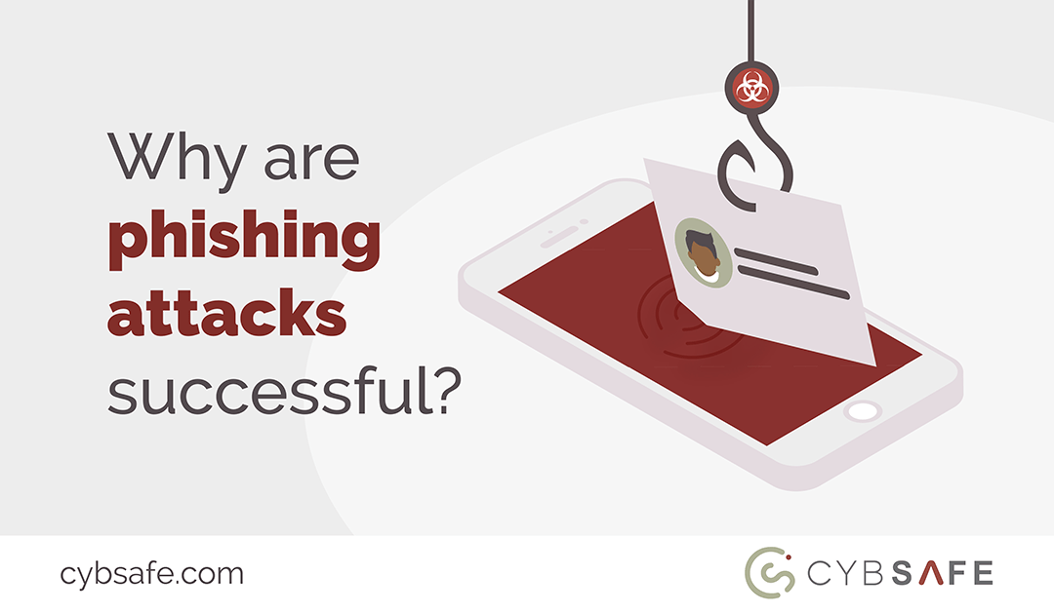
Why Social Engineering Succeeds
Exploits Trust: People naturally want to trust others, especially if the attacker claims to be an authority figure
Creates Urgency: Scams create artificial panic, making victims act quickly before they have time to think logically
Plays on Curiosity: Offers for free items, exclusive information, or shocking news lure people into clicking malicious links
Leverages Fear: Threatening legal action, account suspension, or job loss frightens victims into immediate compliance

Slide 9
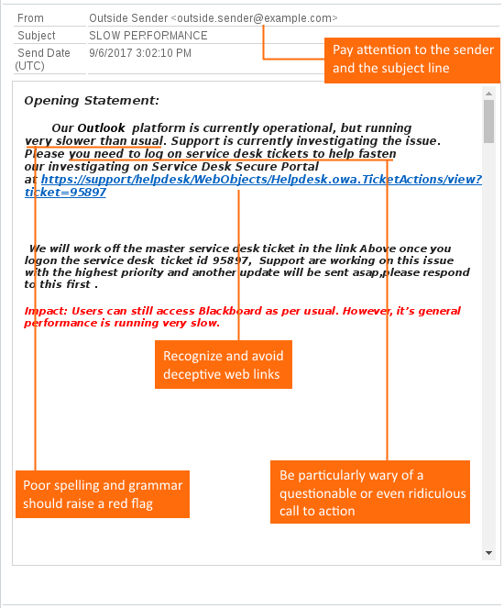
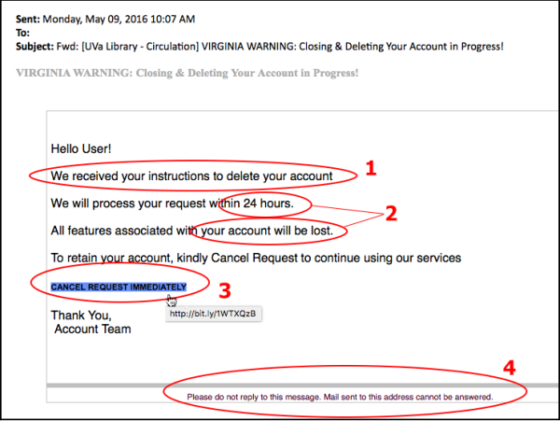
.

Slide 10
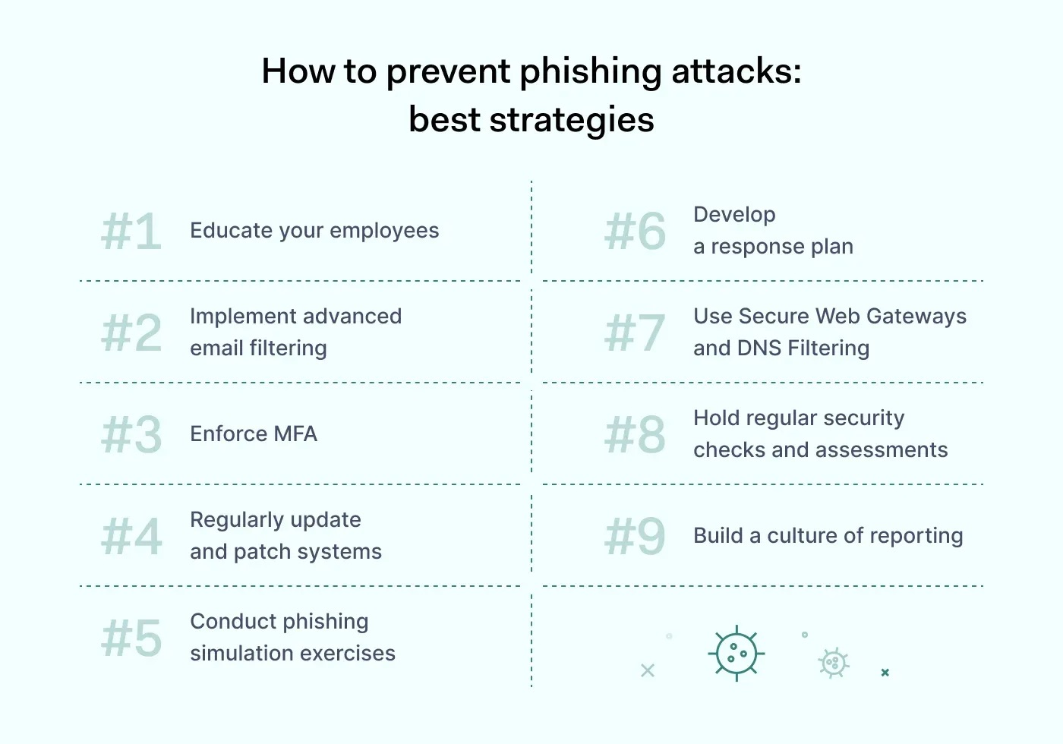
Best Practices

Slide 11
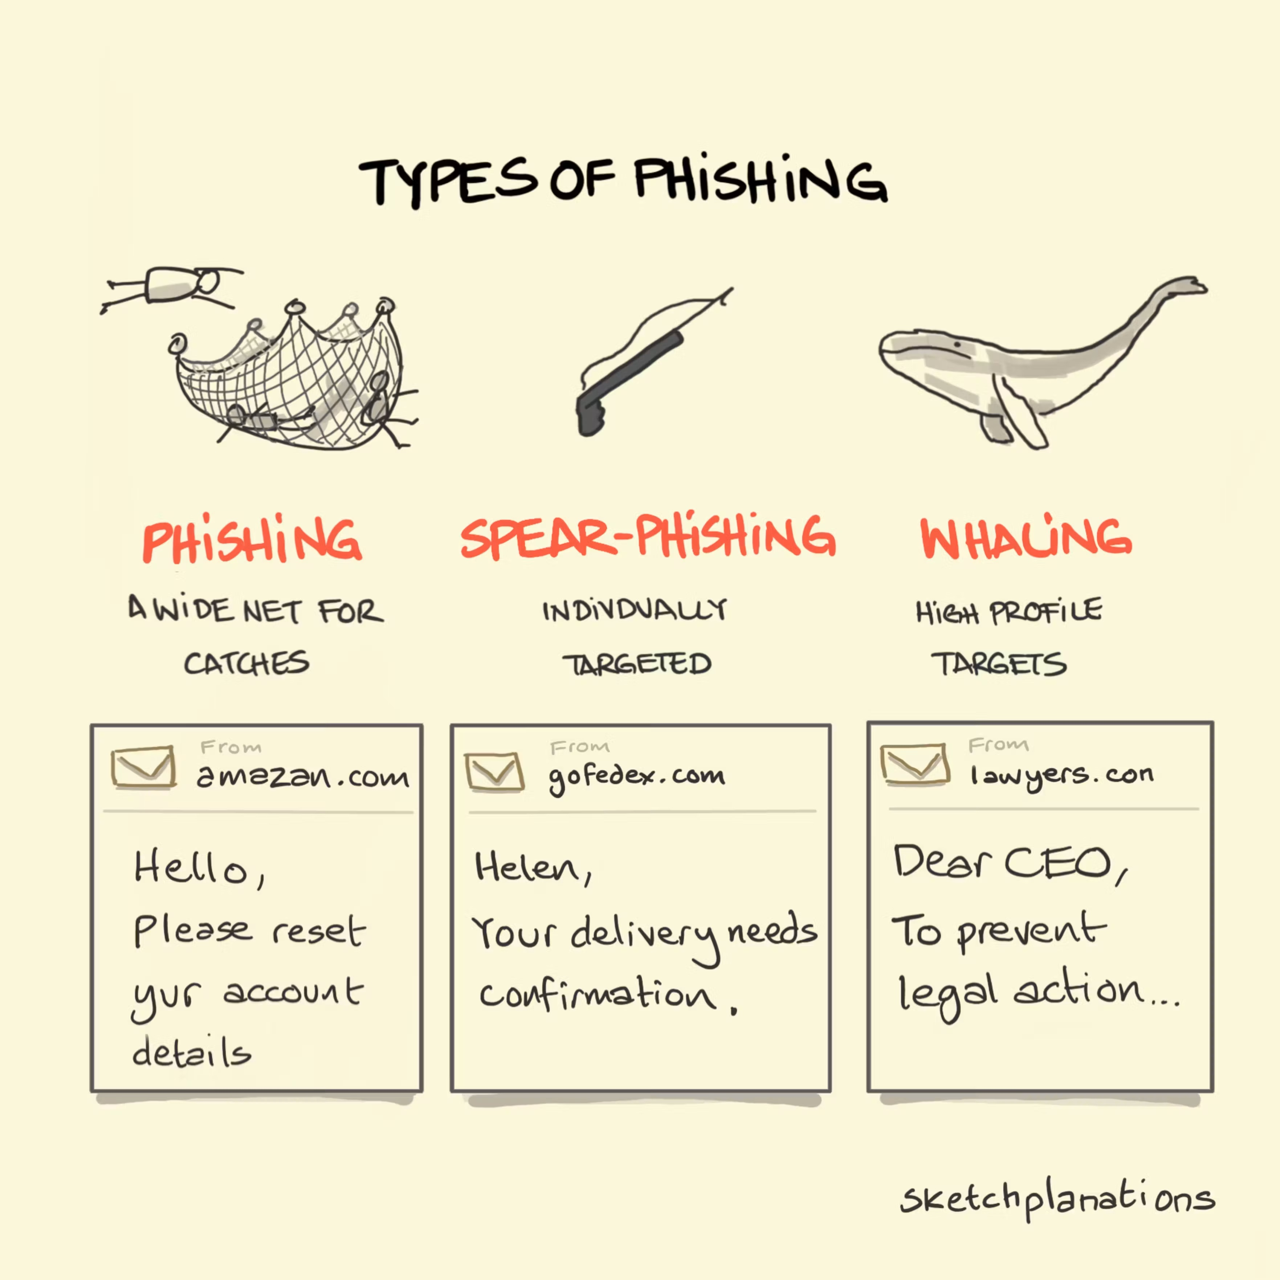
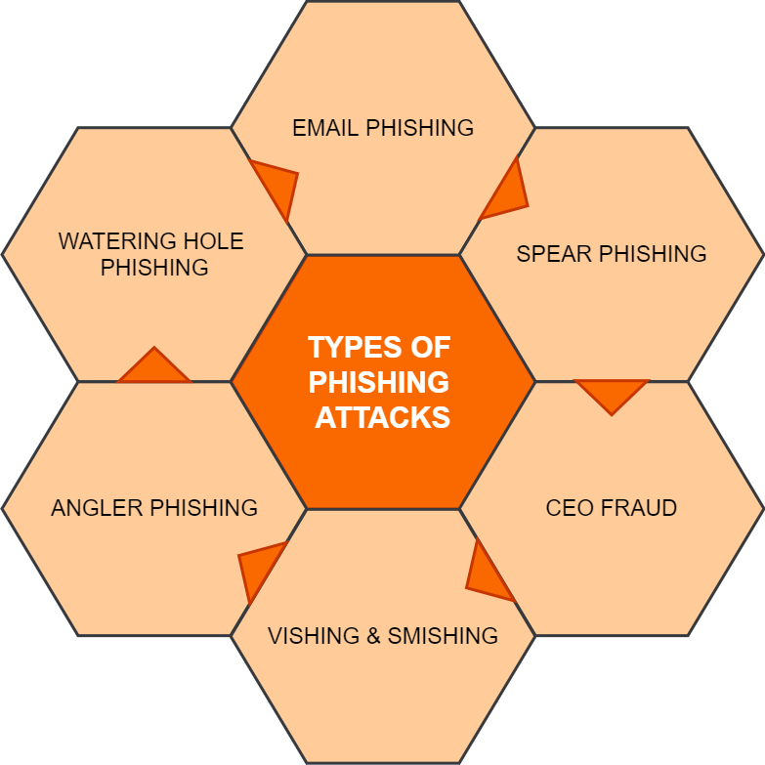
Types of Phishing

Slide 12
Can You Spot The Phish? Take this interactive Phishing Quiz and Test Your Knowledge https://docs.google.com/forms/d/e/1FAIpQLSfD6IVjqBRUW_OIvo9xxeMik7Q0Q4cTUMndgRZiMPIlJkSi4A/viewform?usp=dialog

